Slide 1
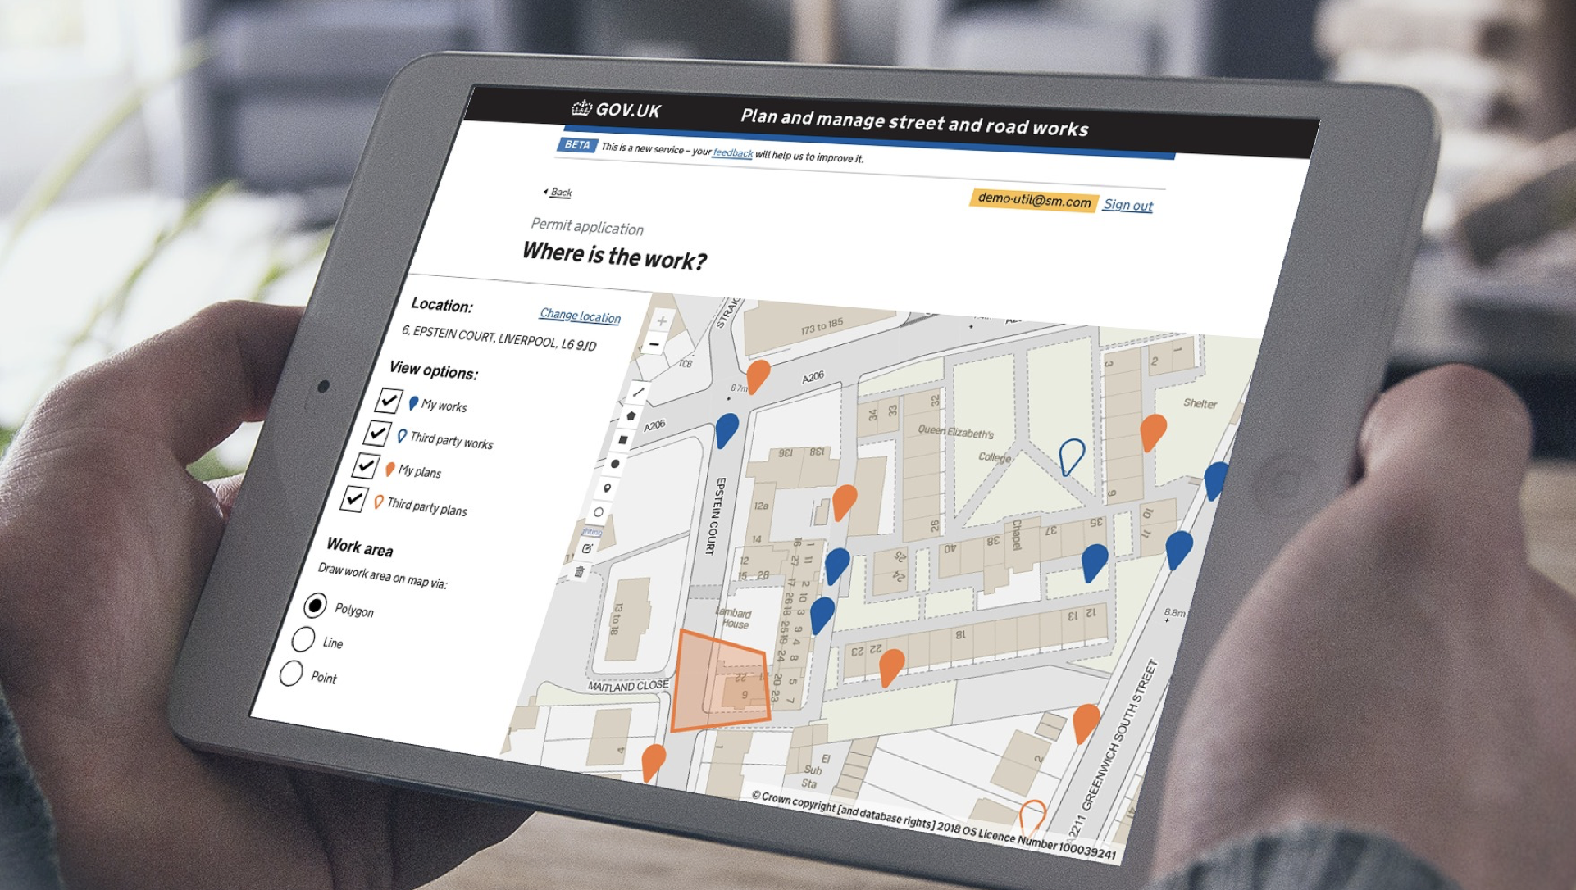

Street Manager Training approach
@ Crown copyright

Slide 2
Contents
Introduction
Overview
Training needs assessment guidance
Training delivery options
Training checklist
Training roadmap

Slide 3
Introduction
Purpose of this document
This document outlines the approach, best practice and some recommended techniques to deliver training to support the transition to Street Manager. The training approach is for users of Street Manager' user interface only. It does not include training on any existing or new systems that you plan to continue using and linking to Street Manager via an API.
The document provides some guidance to assess the training needs of stakeholders by looking at how and when they will use the system and contains a number of questions that you may want to consider when planning and delivering training.
The document is intended for guidance only and you are free to use any method, model or approach that suits you and your organisation’s needs.
You may also want to consider using the Engagement and Training tracker for detailed needs assessment and tracking of activities and progress down to individual stakeholders. You can find the tracking tool here : Link to document
Disclaimer
The information provided in this pack is purely a recommendation and it is up to you to edit the content in line with your organisation’s transition plan. What the right approach for your organisation is will be dependent on a number of factors such as how and when you plan to move to Street Manager environment, and what are the specific needs and preferences of your stakeholders.

Slide 4

Training approach overview
All stakeholders who will be involved in managing works in the Street Manager world feel prepared and comfortable with the new ways of working and system (if Street Manager UI/website will be used)
Training is provided in timely fashion in advance to allow stakeholders to absorb it and adjust to the new ways of working
The benefits of the training plan are clearly visible to all to ensure support and sign-off by management in your organisation if needed
Agile delivery of training to ensure relevance of materials in alignment to agile product development with materials update as needed
You will be ultimately responsible for training management including dispersing materials to your stakeholders as well as individual stakeholders’ needs assessment. DfT will provide you with training materials that you can use within your organisation and will support setting up cross-organisations digital channels that can facilitate training delivery (e.g. FAQs or online forums - exact channels to be confirmed).
Iterations - training will need to be delivered in iterations to align with the agile development of Street Manager and releases of new features
Different needs - user training needs will differ based on UI vs API adoption method - UI users will need comprehensive system training, while API users will need to understand any changes of processes and ways of working
Capability development approach
Objectives
Training needs assessment
Training plan
Training delivery
Considerations

Slide 5
Training needs assessment
Things to consider
Who needs training?
What do they need to be trained on? (i.e. Street Manager system, processes, workflows, etc.)
Would there be differences in the training needs of different teams or individuals?
Preferences versus feasibility - what is the most effective, but still efficient way to deliver training? (e.g. you might want to consider approaches such as digital training, group training or train the trainer / peer support)
Training needs assessment guidance
a) Based on user type
b) Based on transition timings (if gradual transition approach is taken)
Users | Training needs
UI users | Ability to test and navigate through the system with confidence. Understanding of change in processes and ways of working.
API users | Understanding of change in processes and ways of working. (Please note that DfT will not be providing training materials for systems other than Street Manager UI, so you will need to source this separately
UI and API users | Ability to test and navigate through the system with confidence. Specific focus on new processes and usage of SM UI vs other systems.
Users | Training considerations
Testers (if applicable) | Users will be introduced to sandbox environment in order to play with the system and get a feel of prior to production. Users will need to be made aware of workarounds.
Early adopters | System will still be in development which will require continuous training on new features. Workarounds might still be in place.
Late adopters | Limitations and workarounds may still exist, so expectation management will be critical. Can rely on existing forums and FAQs.

Slide 6









Methods overview
Note, these are just examples of techniques you can use. This is not an exhaustive list and you decide what to use and how.
Methods |  | Delivered by | Reach | Impact | Cost and effort | Considerations
 | Reference material | DfT / Project* | Wide | High | Low | Need to keep up to date
 | Online community forum | Users - enabled by DfT / project* | Medium to wide | Medium to high | Medium (cost and effort to set up) | System restrictions
 | FAQ | DfT / Project* | Wide | Medium to high | Low | Need to keep up to date
 | Videos | DfT / Project* | Wide | High | Low
 | Exercises available online for independent training | DfT / Project* | Wide | Low to medium | Low
 | Video conferences | DfT / Project* | Medium to wide | High | Low cost, high effort | Ability for Q&A
 | F2F drop-ins | Project* | Medium to wide | High | High | Ability for Q&A
 | Train the trainer | DfT / Project* | Narrow | Medium | Medium to high | Dependent on trainer’s capacity
 | Hints and tips on Street Manager | System | Wide | Low to medium | Low (built in)
*The term ‘Project’ here refers to your organisation’s internal project/initiative to transition to Street Manager
6

Slide 7



Training checklist
Now
3 months before
1 month before
1 week before
Identify the training needs of all your stakeholders
Deliver first iteration of training
Ensure all stakeholders have access to training
Collect feedback
Adjust training delivery approach if needed
Deliver second iteration of training if needed
Collect feedback to ensure that all stakeholders are ready to deliver BAU processes in the Street Manager world
All points on this checklists are recommendations only that you can choose to do at any point in the lead up to transition

Slide 8
High-level training plan
Scope update
Training Supplier | Now | Before transition has commenced | During transition | Just before completion of transition
Dft Project |  | Survey
Organisation
Training: iteration 1
Training: iteration 2 (tbc)
Web /F2F conferences
Web /F2F conferences
Feedback
Training needs assessment
Transition Date Announcement
Training announcements
Training announcements
Training management and co-ordination
Break into specific activities as suitable for your stakeholders

